Slide 1
CUDA Advanced Libraries
cuDNN Syntax

Slide 2
General cuDNN Steps
Create cuDNN handle
Create tensor descriptor
Get data
Configure activation mode (sigmoid, rectified linear, etc.)
Configure activation descriptor
Run neural network with activation direction (forward, backward, etc.) on input data
Output results

Slide 3
Create cuDNN Handle
Pretty easy to initialize and create handle
cudnnHandle_t handle_;
cudnnCreate(&handle_);

Slide 4
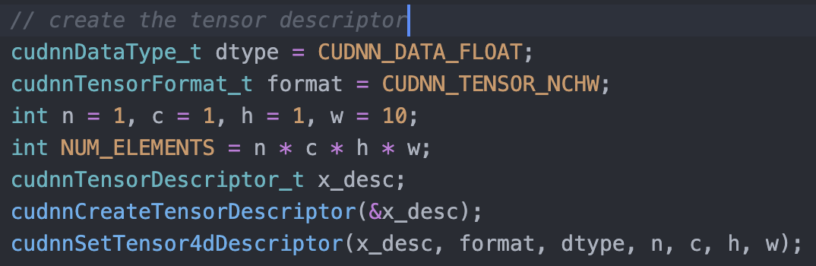
Create Tensor Description
n – number of images
c – feature maps per image
h – height per feature map
w – width per feature map
[1]

Slide 5
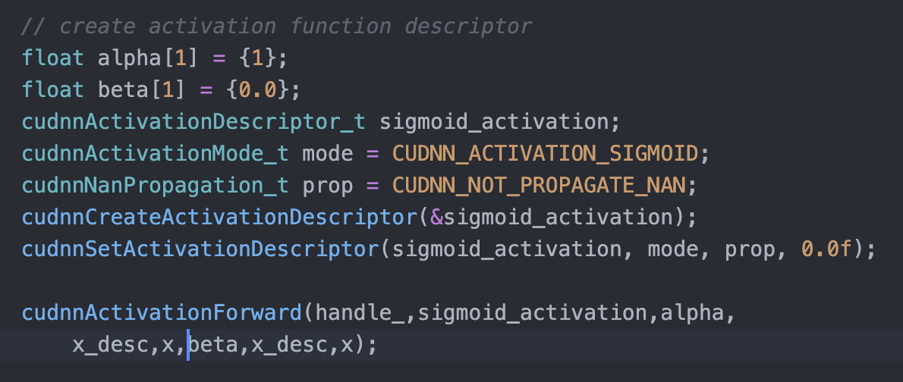
Configure Activation and Run

Slide 6
References
[1] 2021. NVIDIA. CUDA Developer Toolkit Documentation – cuDNN. Found at https://docs.nvidia.com/deeplearning/cudnn/api/index.html - cudnnSetTensor4dDescriptor.

